Slide 1
Demystifying Java Virtual Threads
Ramkumar Sunderbabu
OpenJDK Committer

Slide 2
Agenda
Quick Recap
Designing Virtual Threads
API
Scheduler
Continuations
Serviceability
Pitfalls
ThreadLocal
Pinning

Slide 3
Recap
Platform Thread | Virtual Thread
>2KB metadata | 200-300b metadata
1MB stack | Proportional to stack depth
>1µs | ~200ns
Terms – Platform/Carrier/OS Thread, Mounting/Unmounting
Misconceptions
VTs are faster
Quicker context switching
Little's Law
Notes:
compare awt/swing :: heavy weight/light weight

Slide 4
API Design
Name – Fiber ? Strand ? Light weight Thread ?
java.lang.Thread has too many baggage, still good choice – easier for adoption
Tiny API surface
async-await Vs Threads
General direction to keep much of the code in Java
async/await | User mode thread
JavaScript, Kotlin | Go, Java

Slide 5
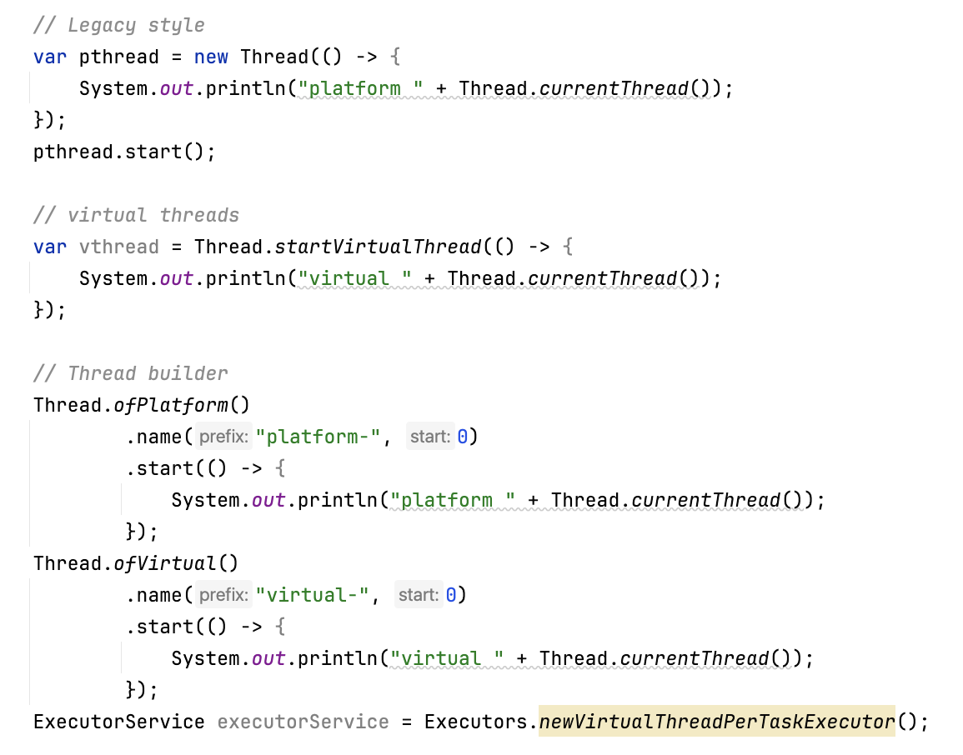
API

Slide 6
Designing Virtual Threads
light weight user mode thread
low footprint and negligible task switching time
someway to abstractly represent control state of the program
efficient scheduler
Virtual Thread = scheduling mechanism + state representation

Slide 7
Scheduler
Why ForkJoinPool – loom-dev mail
ForkJoinPool - FIFO mode, parallelism = Runtime.getRuntime().availableProcessors(), maxPoolSize = 256
ForkJoinPool is already
heavily optimized
well-tested in JDK
tuned for parallelism
Not a fair scheduler – not apt for CPU bound task
No public API to choose scheduler
Notes:
https://mail.openjdk.org/pipermail/loom-dev/2022-October/004972.html
Customization Vanilla ForkJoinPool Virtual Thread Scheduler
Worker factory Default threads Custom daemon carrier threads
asyncMode false (LIFO for owner) true (FIFO for owner)
Task unit ForkJoinTask Runnable (continuation wrapper)
Exception handler Default Custom (protects carrier)
Pool expansion Manual Automatic on pinning via ManagedBlocker

Slide 8
Continuation
Non-reentrant, Delimited, Asymmetric, Multipronged
Important methods – constructor, yield, run
Tempting to expose as public API
blockingMethod() {
Continuation.yield(VT_SCOPE);
}
unblockingMethod() {
vt_scheduler.submit(continuation)
}
How does Loom’s scheduler know that a method is blocking? It doesn’t.
Notes:
Show Continuation demo
a continuation is an abstract representation of the control state of a computer program. A continuation implements (reifies) the program control state, i.e. the continuation is a data structure that represents the computational process at a given point in the process's execution; the created data structure can be accessed by the programming language, instead of being hidden in the runtime environment.
a delimited continuation, composable continuation or partial continuation, is a "slice" of a continuation frame that has been reified into a function.
~/Tools/jdk/openjdk-21.0.2/Contents/Home/bin/java --add-exports java.base/jdk.internal.vm=ALL-UNNAMED /Users/rsunderb/Tools/IdeaProjects/TestCode/src/javafest/ContinuationYield.java

Slide 9
Continuation…
Copying terminology
Freeze – suspend a continuation and unmount it by copying frames from OS thread stack -> continuation object
Thaw – mount a suspended continuation by copying frames from continuation object -> OS thread stack
Advantage
No change to compiler/interpreter; same frame layout, same stack banging
No change to native calls
Disadvantage
Cost is O(stack depth)
Notes:
JVM knows their layout, size, references, everything. It can serialize them to heap and restore them later

Slide 10
Unmount - Freeze
…
…
A
C.run()
C.run()
B
A
C
B
C.yield
C
C.yield

Slide 11
Mount - Thaw
…
…
A
C.run()
C.run()
B
A
C
B
C.yield
C
C.yield

Slide 12
Serviceability
Addition to
JFR Events
Thread dump format
JDWP agent options
JVMTI spec
JDWP spec
scale to millions of threads
Notes:
Implementation challenge – Most of the code in Java but JVMTI is in C

Slide 13
Pitfalls
ThreadLocal
Pinning
Deadlock

Slide 14
ThreadLocal
ThreadLocals need memory created per thread.
StructuredScope – better alternate for Virtual thread use case

Slide 15
Virtual Thread pinning
VT cannot be unmounted during blocking operations because it is pinned to its carrier:
When it executes code inside a synchronized block or method, or
When it executes a native method or a foreign function.
Detection
-Djdk.tracePinnedThreads=full/short
JFR event - jdk.VirtualThreadPinned
Pinning in synchronize fixed in JDK 24
JEP 491: Synchronize Virtual Threads without Pinning
Notes:
Foreign function - https://openjdk.java.net/jeps/424

Slide 16
Jacking up the JDK
1,133 changed files with 95,870 additions and 8,270 deletions.
Java 13
JEP 353 Reimplement the Legacy Socket API
Java 15
JEP 373 Reimplement the Legacy DatagramSocket API
JEP 374 Deprecate and Disable Biased Locking
Java 18
JEP 416 Reimplement Core Reflection with Method Handles
Notes:
https://bugs.openjdk.org/browse/JDK-8284161
https://github.com/openjdk/jdk/commit/9583e3657e43cc1c6f2101a64534564db2a9bd84
1,133 changed files with 95,870 additions and 8,270 deletions.
Authored by who's who

Slide 17
ಧನ್ಯವಾದಗಳು 🙏
Notes:
Doubts
Will JEP 491 be backported to JDK 21?
Will reactive programming disappear?

